Slide 1
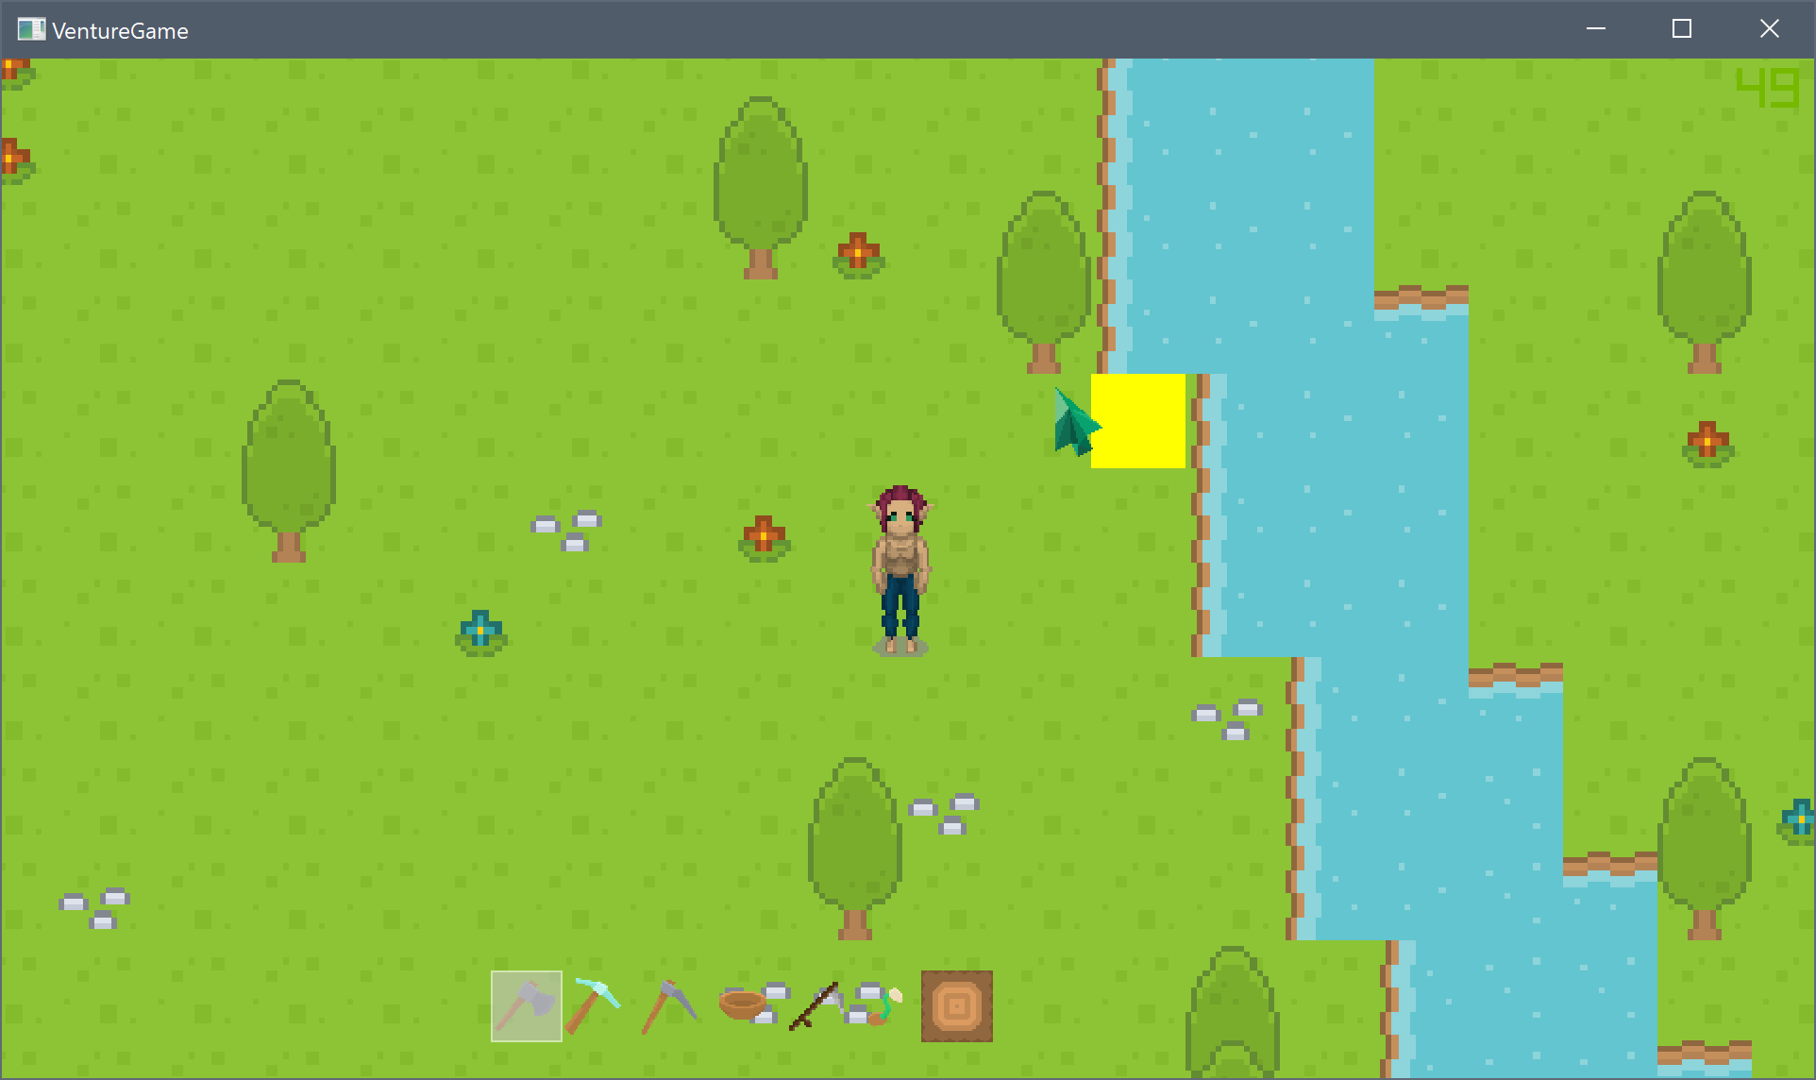
Project:
For this optimisation and porting task I will be using a game I was working on over the summer.
The game is a top down open world multiplayer farming game called Venture.
The game is getting roughly 20-30FPS in debug build, which isn’t much considering the content in the game, and in release build the game runs better, but there is memory issues when explore the world.
Engine:
The game was developed in C++ with SDL and used the boost::asio library for the networking. However, for the scope of this project and to ease the port to PS4 I will be removing the networking from the game, and focus on the single player optimisations. Furthermore depending on the support for SDL on the PS4 I may be looking into converting to the PhyreEngine for the rendering as that will also improve the performance.
Game Features:
Character customisation
Level saving / loading
Player saving / loading
Procedural terrain generation
A chunk based level system
Inventory system
Farming and terrain manipulation
Profiling Tools:
Visual Studio profiler is a very useful tool within visual studio that can profile the CPU, memory and GPU (only using the directX).
RenderDoc may be useful for if I decide to overhaul the SDL rendering and use openGL instead, this will be able to help profile the openGL rendering pipeline.
Other Notes:
During the optimisation of this game, over the easter period, I spent mostly working on game bugs and fixes, and getting some old code working, which I could optimise.
This means that I have structured this document into two sections, one before the new features and fixes, and one after.

Slide 2
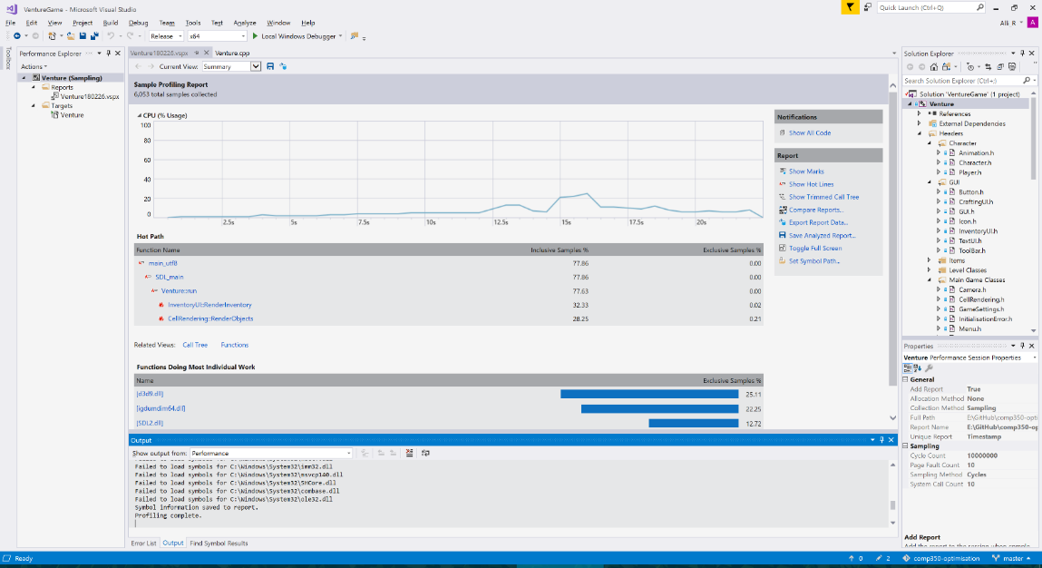
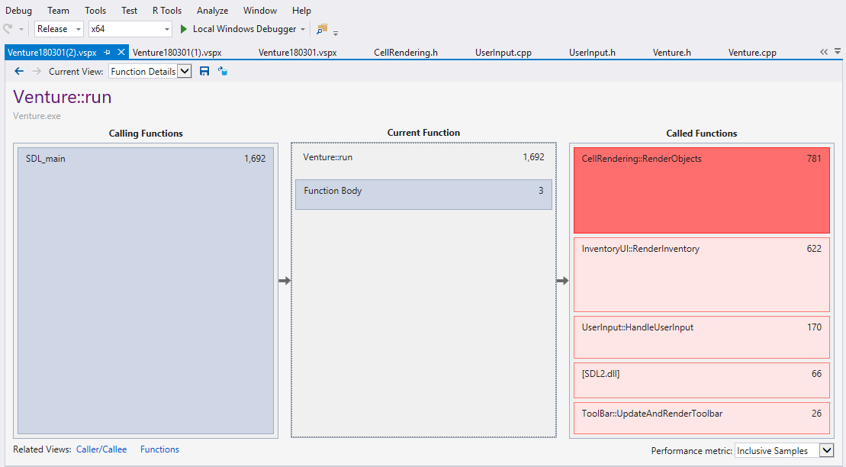
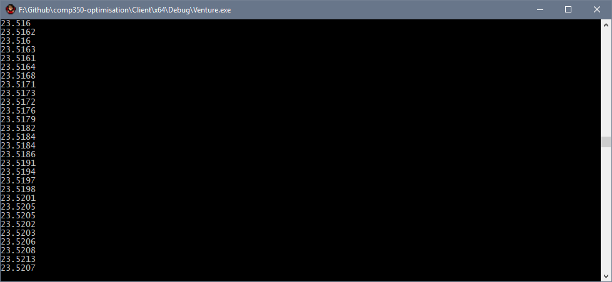
Benchmark:
Measure:
To benchmark I started with the visual studio profiler, this highlighted what functions where using most of the resources.
There is a clear spike where I had opened the players inventory, as well as when the level was being generated
The key functions that are affecting the performance the most is RenderObjects, which renders the levels cells.
I will start by looking at how the rendering is working, to see why this is an issue.
I also implemented a way to check the time it takes to render a frame,
however this only works in debug, where I have access to the console.
<- This is the FPS I am getting when idle in debug.

Slide 3
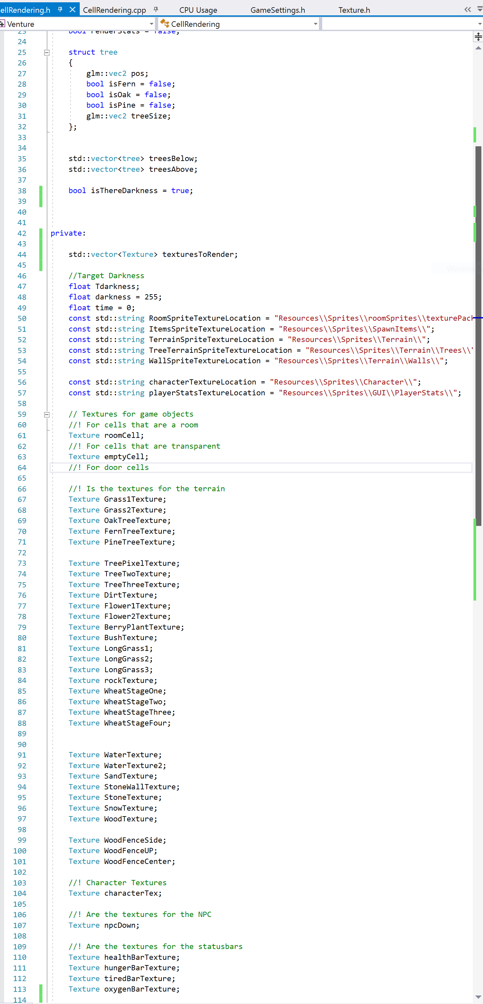
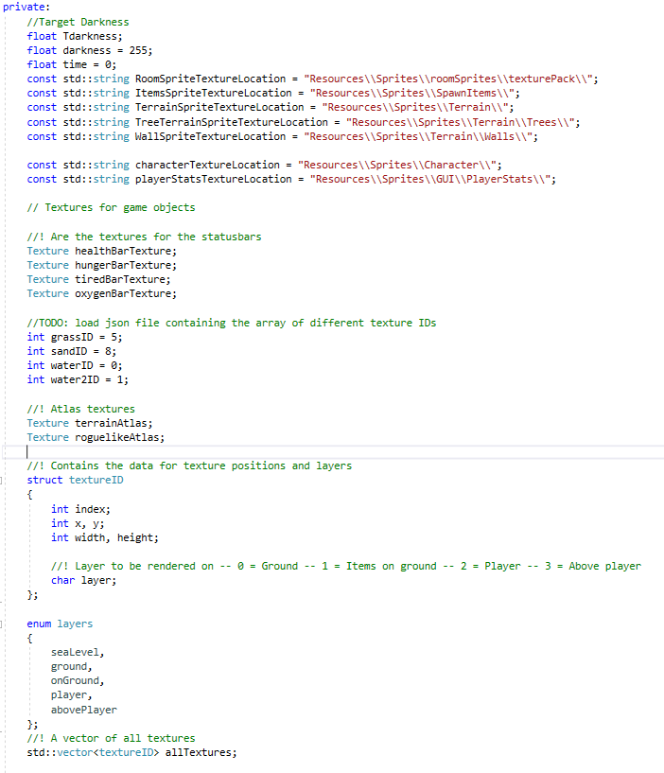
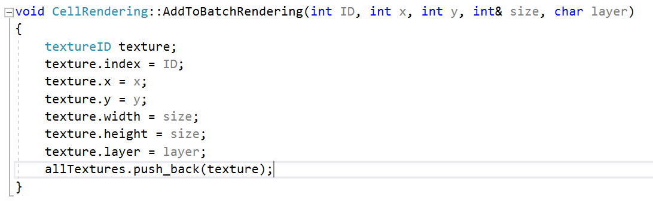
Detect:
Solve:
The way the textures get loaded into the game is I created a texture class that loads each texture as a separate image, and it does this for every tile generated.
To Solve this issue, I worked on creating a renderAtlas function in the Texture class, this will take an ID for the sprite and get that sprite from the atlas and render it to a point in the game.
To do this, I created a struct that contained the location of the sprite, the atlas index number and the layer.
I also created a vector of all the textures, so that I could batch render all the textures at the end of the frame.
So each texture loaded in meant that as you explored the world the memory usage will gradually increase and performance would decrease.
I also removed the rendering of the trees issue, by removing the two vectors of trees. Instead I used an enum to store the layer of each sprite, and that decides when the texture will be rendered.
This method also meant I had to do a few hacks to get the trees rendering properly.
The image to the left shows I had two vectors, one that contained the trees that were to be rendered above the player, and another that was to be rendered below.
This could be avoided by creating a batch renderer.
Moreover, there are a lot of Textures for each game object, which is not maintainable as the game scales.

Slide 4
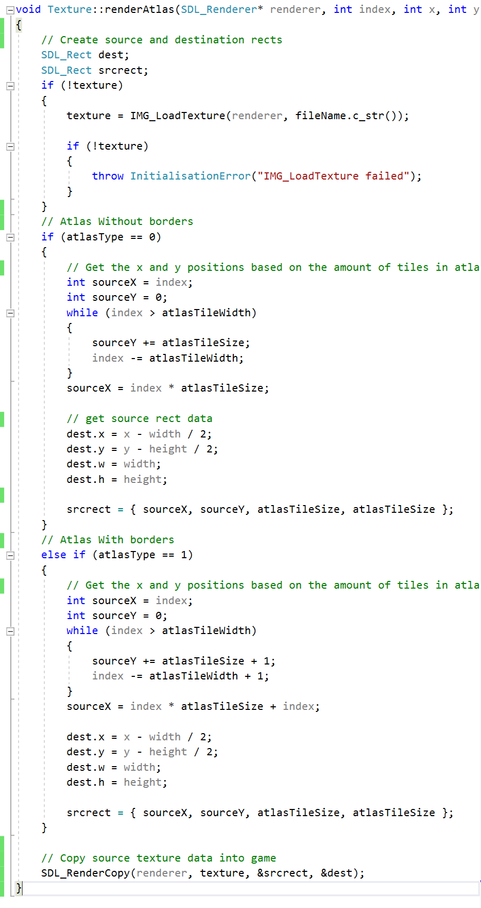
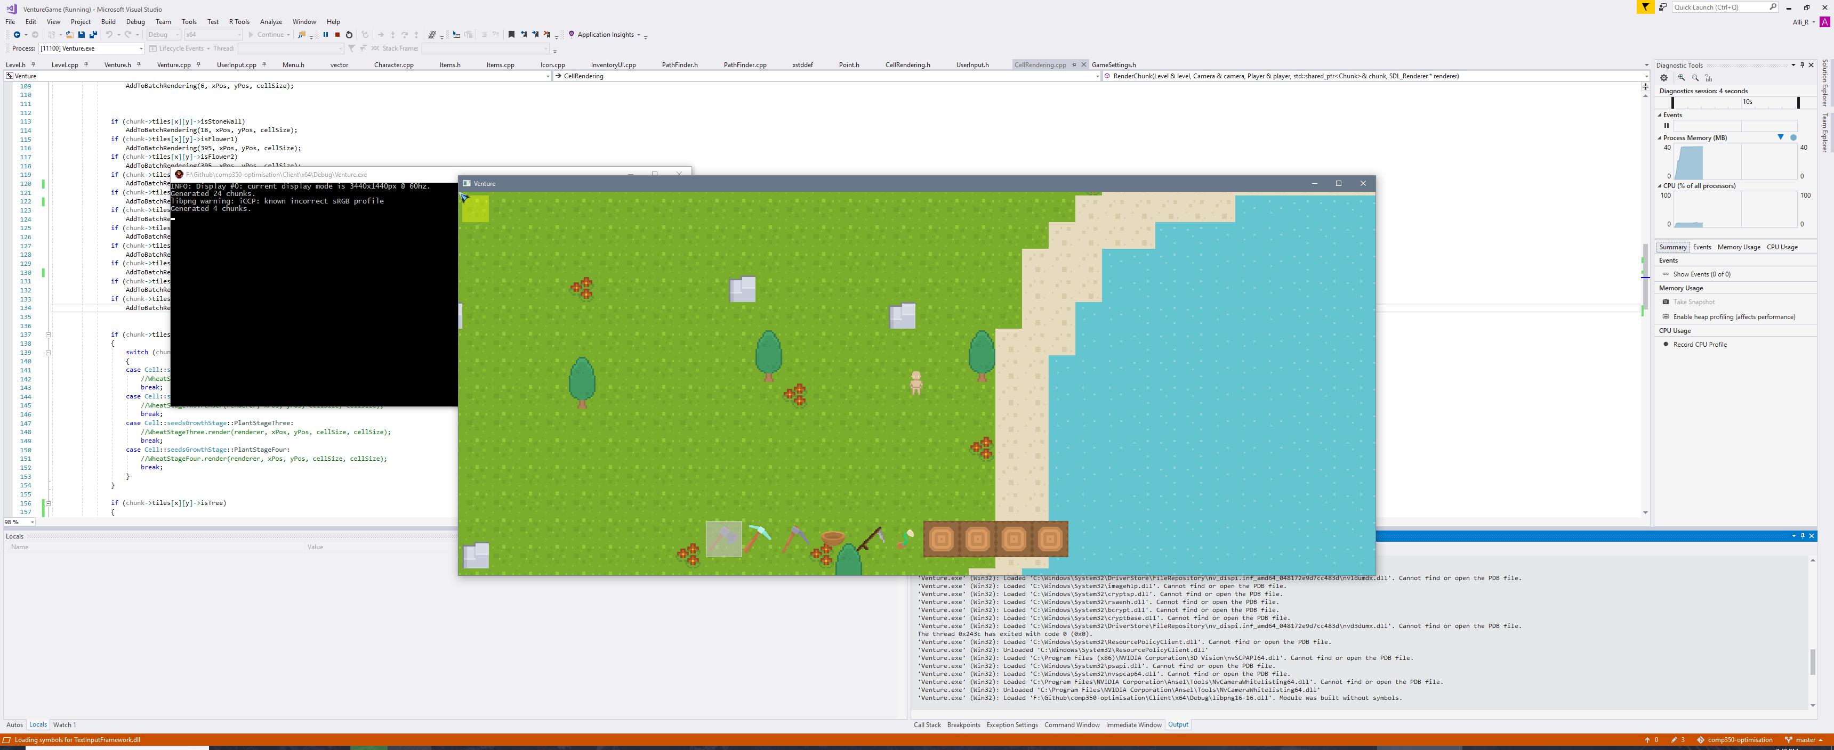
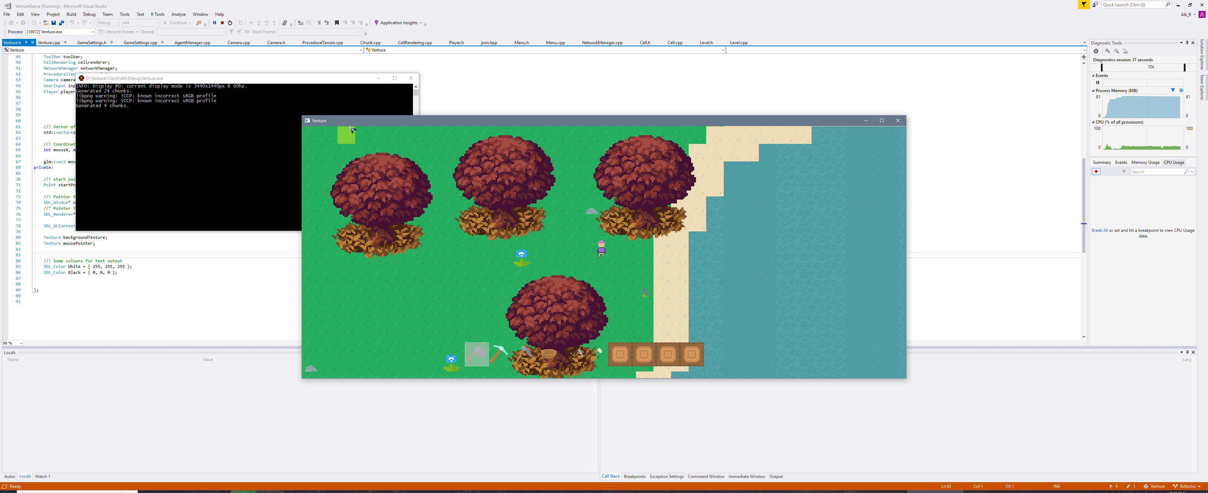
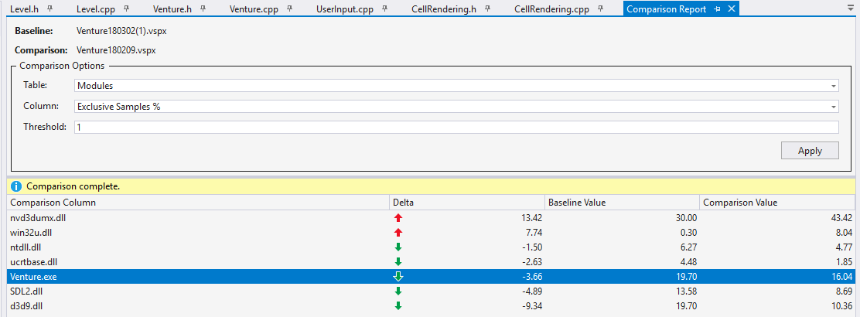
Solve:
Check:
The new texture render atlas function
This change means that now the game doesn’t create a new texture for each cell as the player explores the level, which results in a much lower memory footprint.
NEW OLD
This function gets the location of a sprite from an atlas, based off the index number which is passed in.
There are two atlas types that I have implemented, one that doesn’t have any borders, and one that has a 1 pixel border between sprites.
In the future if there are more than two types of atlas’, I will try to streamline this code to be more maintainable, however for the two types that I have this was the easiest way I saw how to implement it.
When comparing the profiler to a previous run, the overall application has a negative delta, which I believe means it ran faster. However this is not a great overall improvement, compared to what I was expecting.

Slide 5
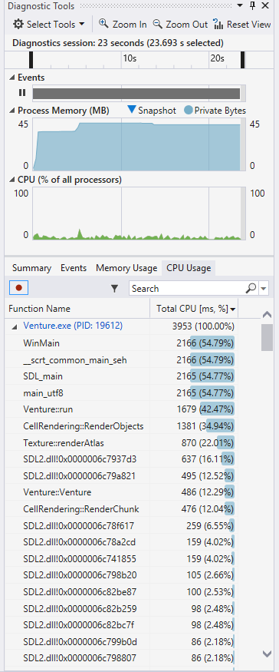
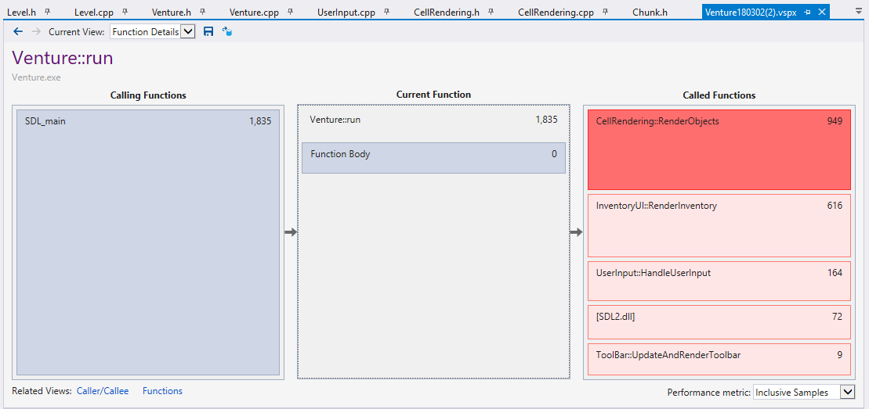
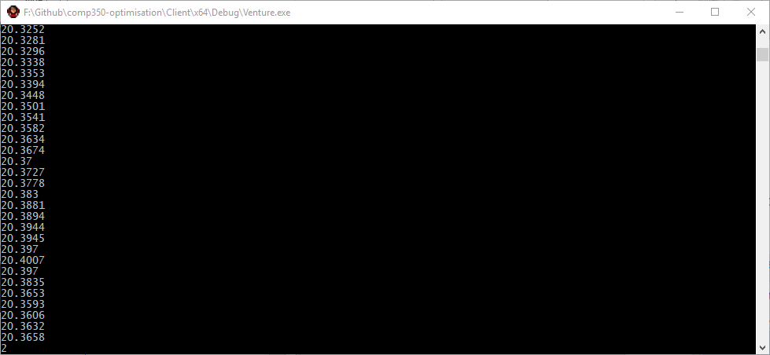
Benchmark:
RenderObjects is still using roughly 35% of the processes overall CPU usage, even though the total CPU usage of the game is very low still, it’ll be worth going into depth to try and optimise RenderObjects further, as this is the main cause of the slow performance at the moment.
When I ran the test again I still found that render objects is sill using a considerable amount of CPU utilisation.
The frame rate in debug is still not optimal, only getting about 20 FPS.

Slide 6
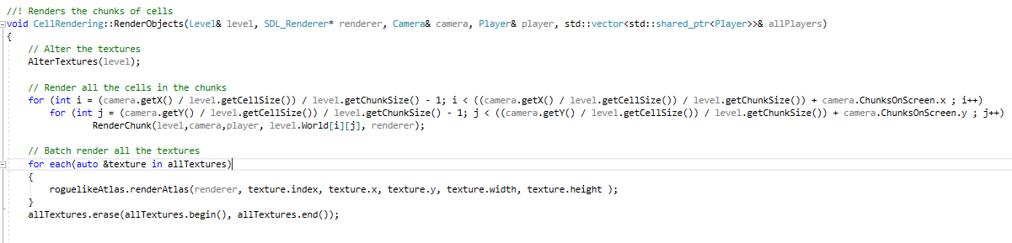
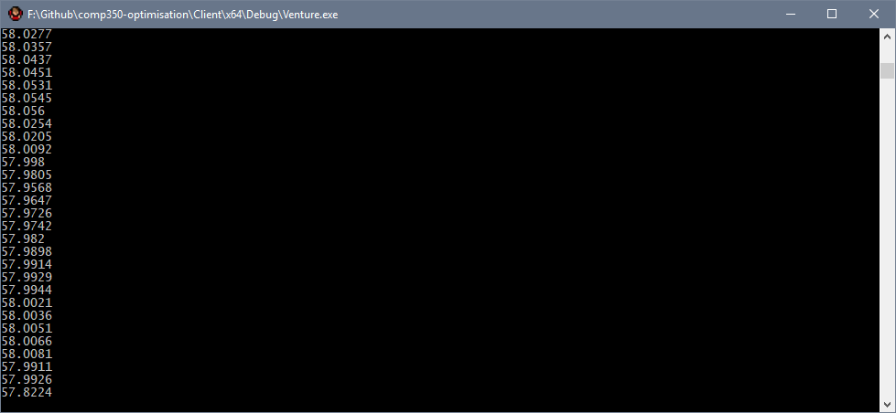
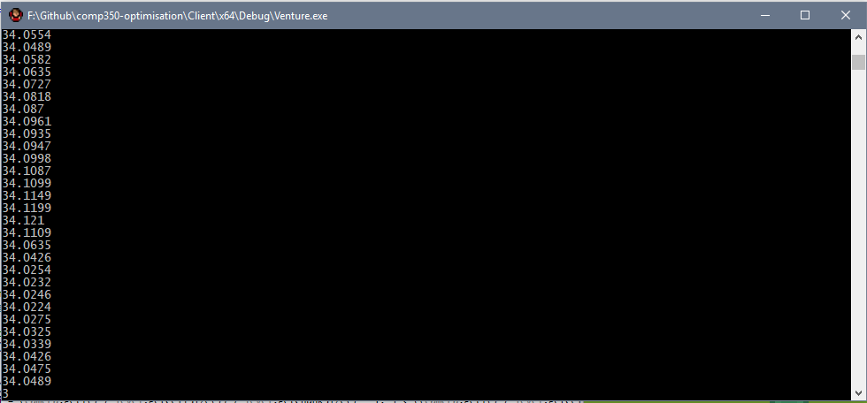
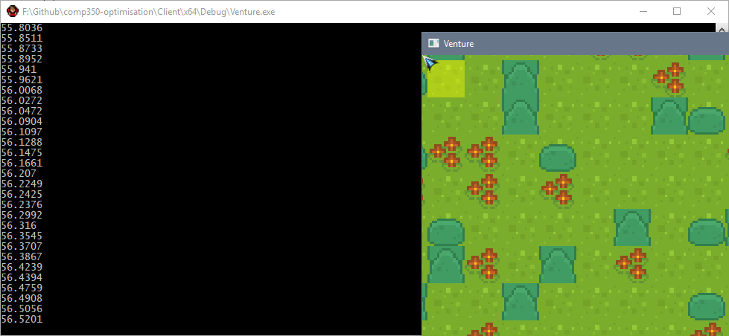
Detect:
Solve:
The main cause of the lag is this small bit of code below, which renders the chunks that are around the camera position. I remember writing this code very late at night so I will go over it and see if there is any areas that can be optimised.
The next thing I did was try to cull as much as possible from outside the players view, to do this I decreased the chunk size, this was extremely surprising.
Previously the chunk size has always been 16, which is 16x16 cells in a chunk. Just to see I reduced the chunk size by half, this gave a huge boost to frame rate.
After playing round with the chunk rendering code, I found that it was actually rendering a lot more cells off screen, that I will be able to cull.
By simply changing the chunk size from 16 to 8 gave an almost 2x change in frame rate!
I tried changing the chunk size by half again, but this actually decreased performance slightly, so the sweet spot seems to be around 8x8 cells per chunk.
I suspect this change may be due to the CPU being able to cache the 8x8 chunks better in the L1 and L2 cache more efficiently.
All I did was removed 1 from the x and y chunks that were being rendered, and this instantly gave an extra 10+ frames per second.

Slide 7
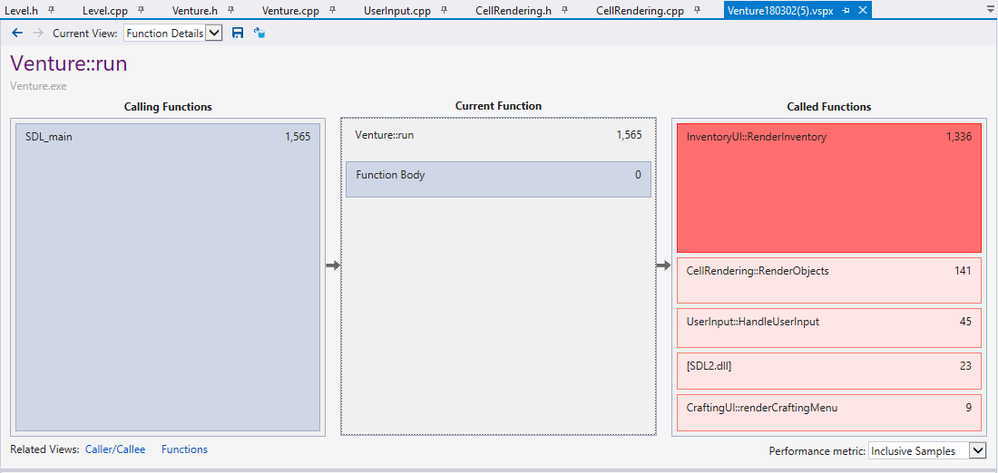
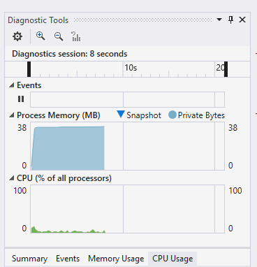
Check:
Changing the chunk size seems to have made such a difference to performance that, the RenderObjects function is no longer the top called function, and was only called 141 times.
That is quite a drastic change from such a small fix, previously the RenderObjects function was being called roughly 1000+ times, where as it is only being called ~150 times now.
I suspect the reason for why the chunk size affected the performance so drastically, was because with a larger chunk size, there are a lot more cells that will be rendered off screen, which are not being culled, so having smaller chunk sizes means there are less cells that will be rendered offscreen.

Slide 8
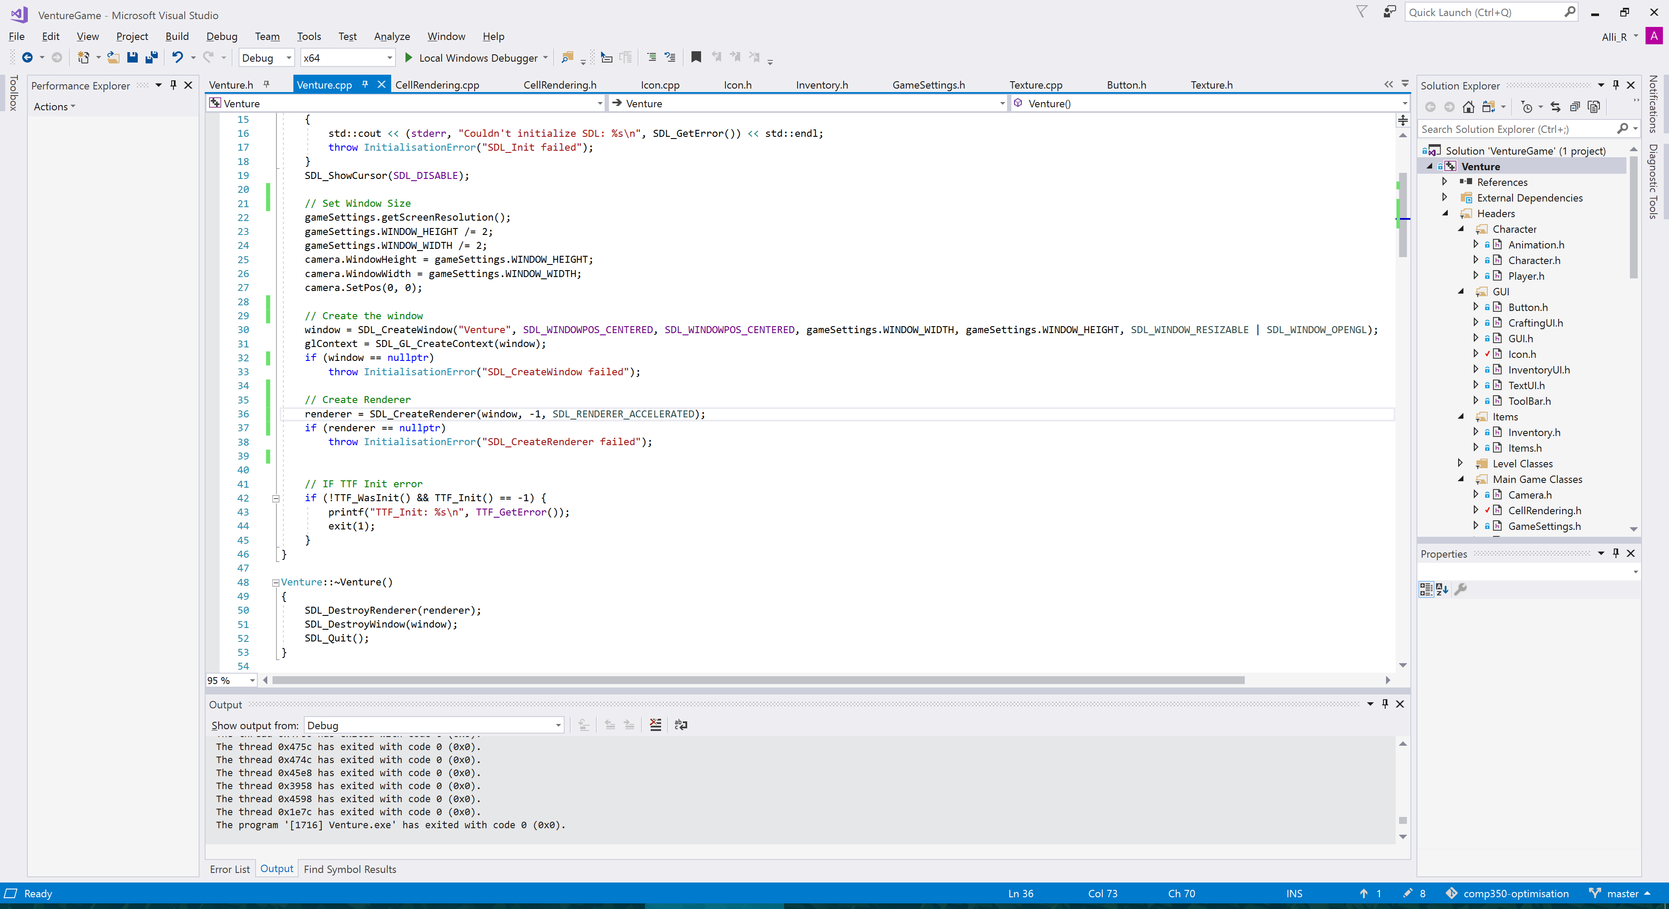
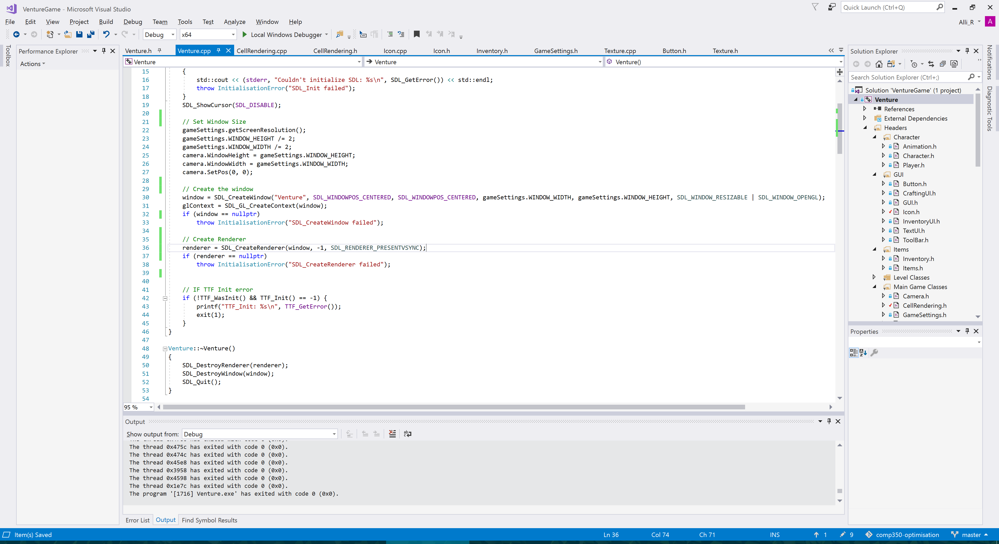
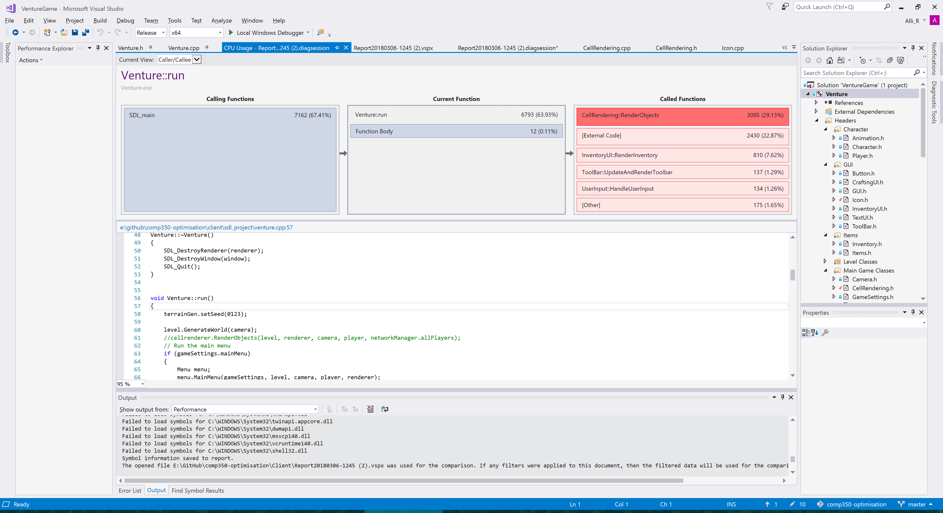
Benchmark:
Measure:
I Tested the four different SDL rendering options, to see which one gave the best frame rate, and from my results SDL_RENDERER_ACCELERATED was the best performance rendering option.
When I was looking testing the frame rate with RenderDoc I found that the frame rate was capped
to 60 FPS, and I figured this was because of Vsync. However the refresh rate on my monitor is 100Hz,
So I started looking at how I could change this.
Solve:
Detect:
One problem I have with this is that because the frame rate is no longer a steady rate, and starts to max out the system, the game seem to speed up and slow down.
This may cause an issue with screen tearing, if the frame rate goes above the refresh rate of the monitor. I may change this back at some point, if it gets too much of an issue, but for now it is useful for measuring the frame rate when it goes above 60FPS.
I simply changed SDL_RENDERER_PRESENTVSYNC to SDL_RENDERER_ACCELERATED.
Check:

Slide 9
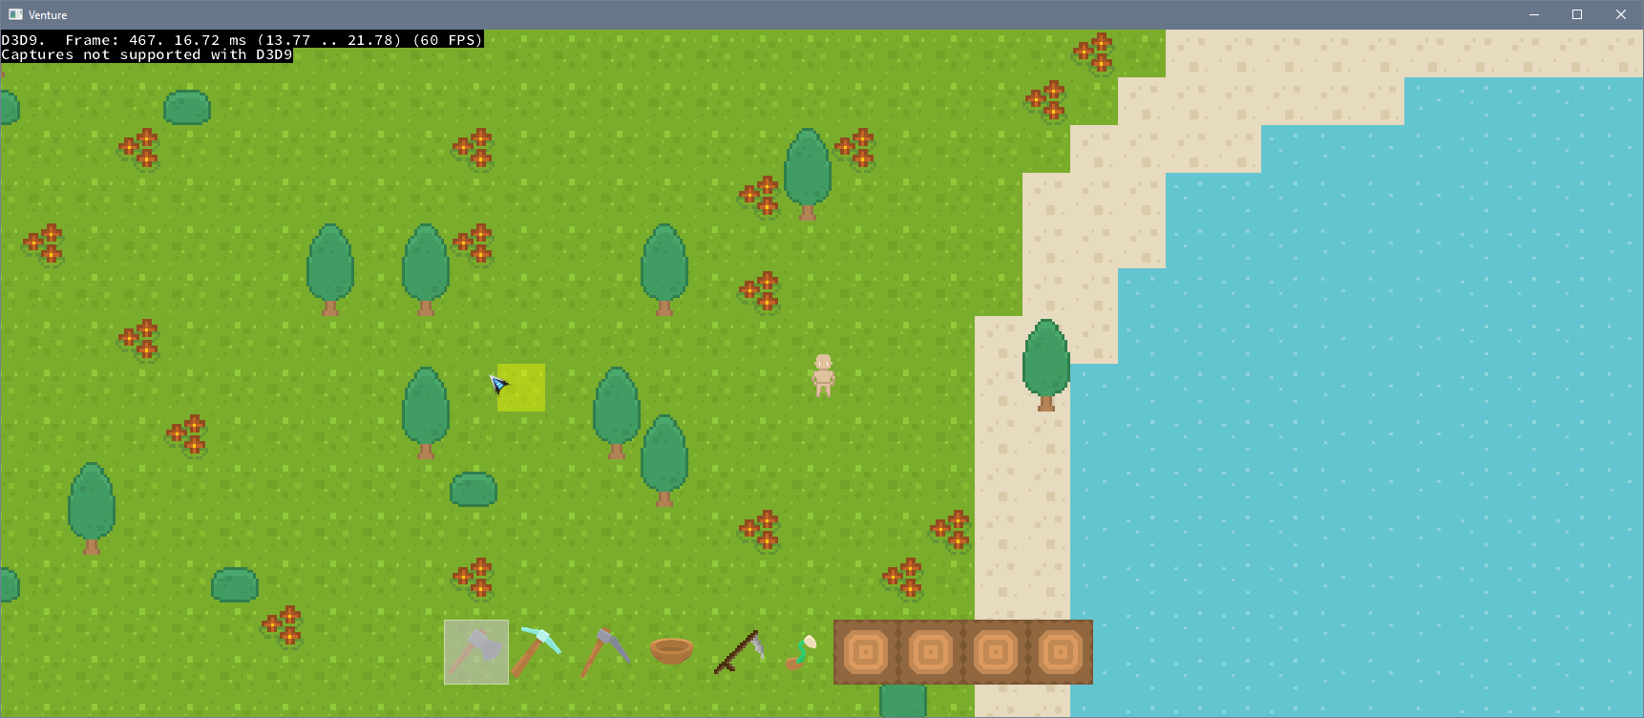
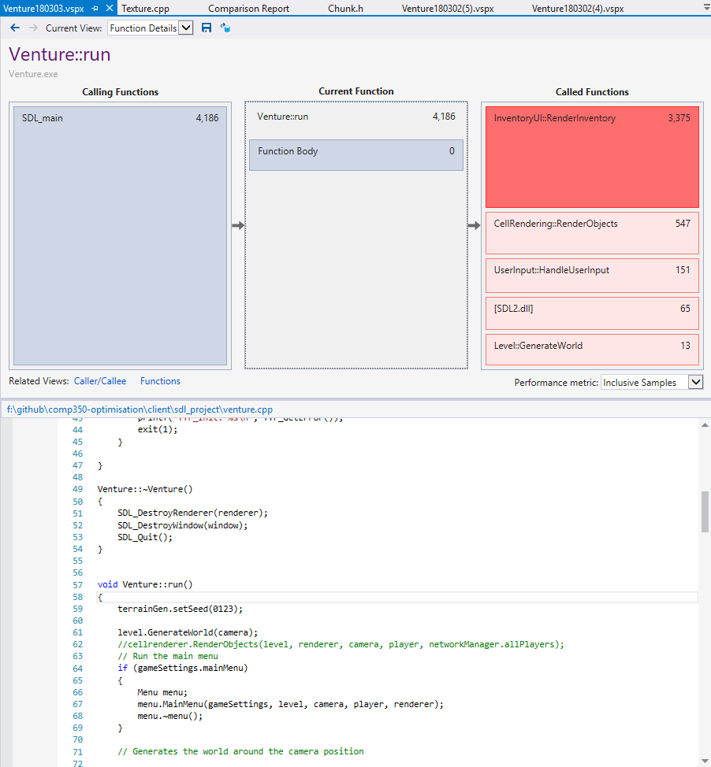
Benchmark:
Measure:
This is now the current version of the game, and in this game I opened the inventory a few times, and this shows that there is some optimising to be done with the RenderInventory function.
RenderDoc now shows I am getting a reliable 60FPS when the game is not being zoomed out.
However this does start to dip when I open the players Inventory. The first thing I will start to implement is a time out for the inventory, because currently the inventory window flashes open and closed when you hold the button down.
Furthermore every time the inventory window is opened it has to refresh the icons in the window, so to start of I will just create a time out for the inventory, so it can only be opened every half a second or something.

Slide 10
Optimisation process restart, with some new game features and fixes.
Over the Easter break, I dedicated some time to fixing old features that were currently not working, like pathfinding, saving/loading and character creation and rendering. So the results on the following slides are the game with these added features and fixes.

Slide 11

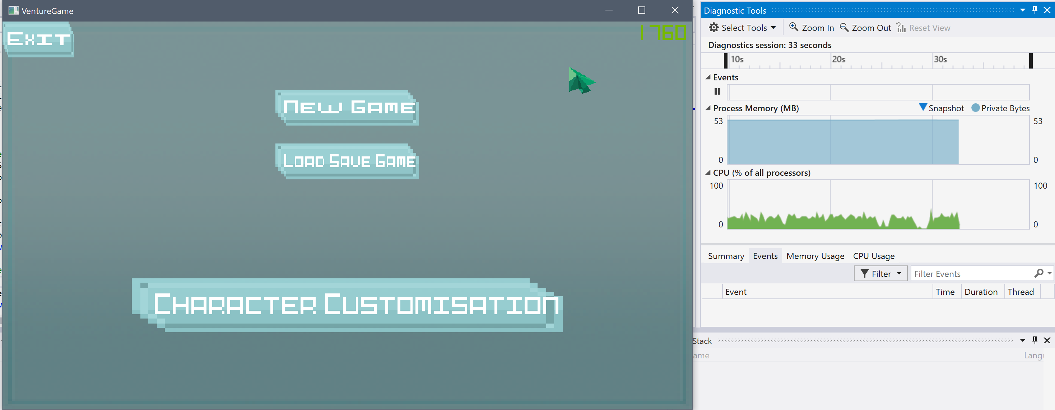
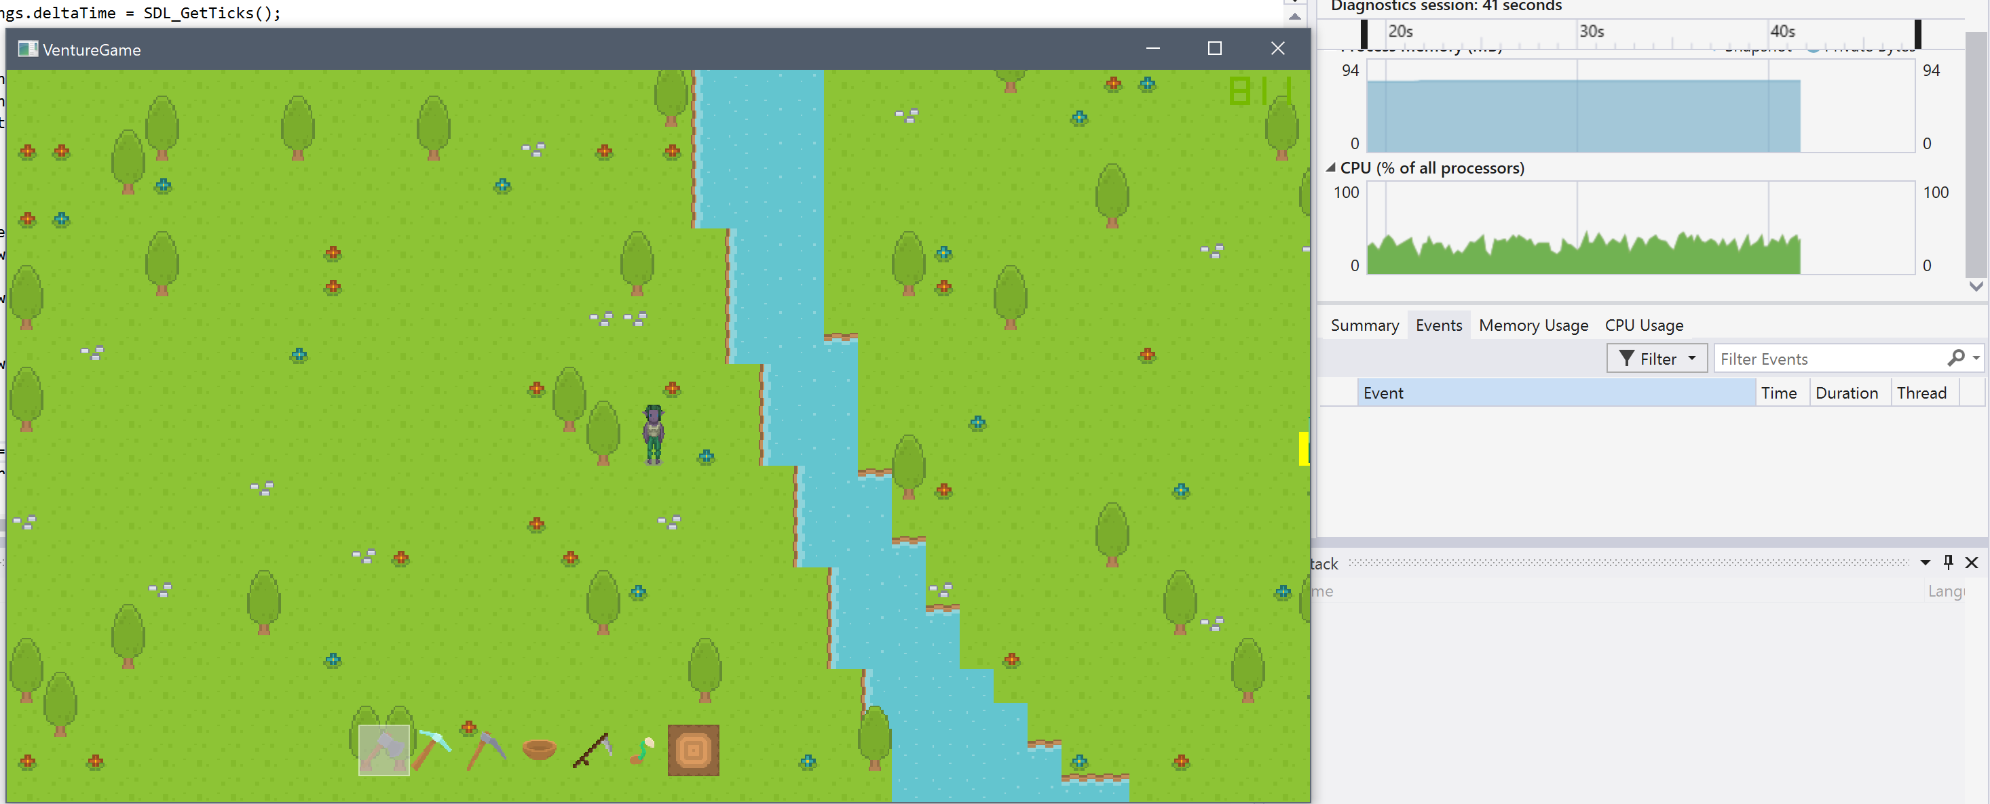
General Profiling Results
Render Chunk is the only function in the hot path that is using a lot of processing power, the other functions are SDL/openGL.
Now that the frame rate is normally over 60FPS, the SDL_RENDERER_PRESENTVSYNC flag that is being passed into the SDL window stops the game from rendering more frames than the refreshrate of the monitor, so to test the raw performance of the game, and not wait for VSYNC, I passed in SDL_RENDERER_ACCELERATED which does not limit the frame rate.
On the Menu screen of the game (above) the game uses at most 25% of the total CPU, this is probably due to the game only being single threaded, and my computer has 4 processing cores.
Render Chunk is the only function in the hot path that is using a lot of processing power, the other functions are SDL/openGL.
Even in game, the processor doesn’t go much above 25% utilisation. One big optimisation I could do would be to make the game mult-threaded, and offload some of the other calculations to another core.

Slide 12

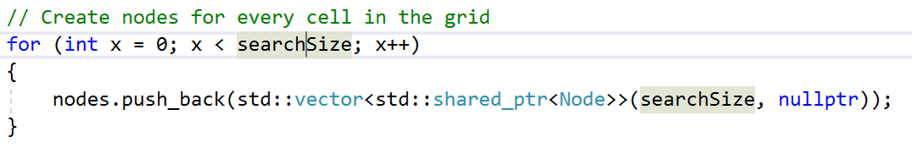
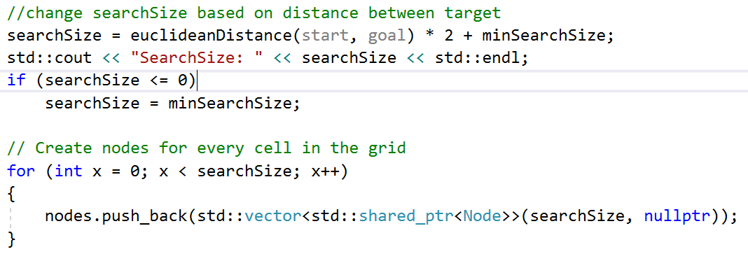
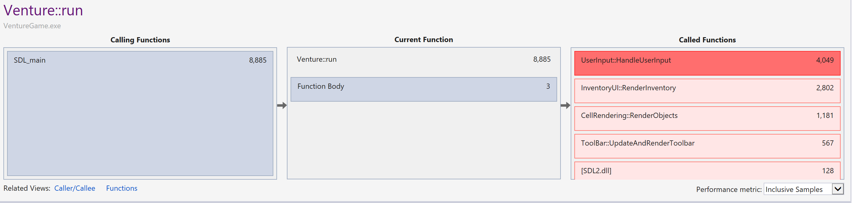
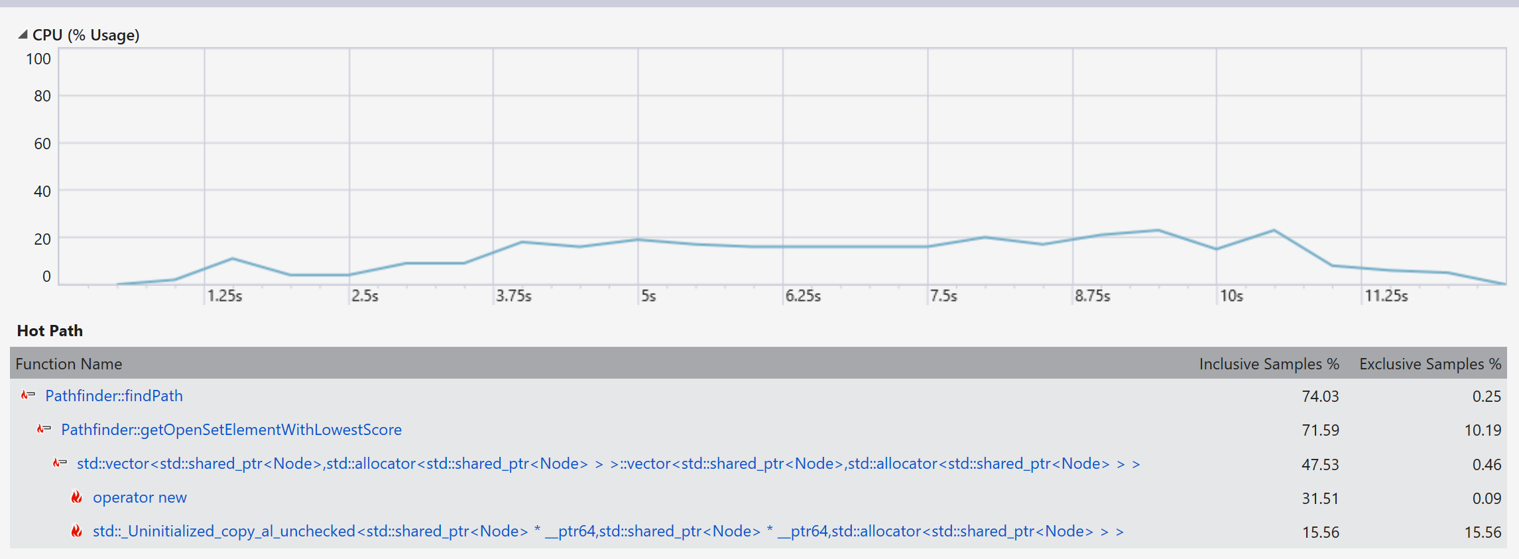
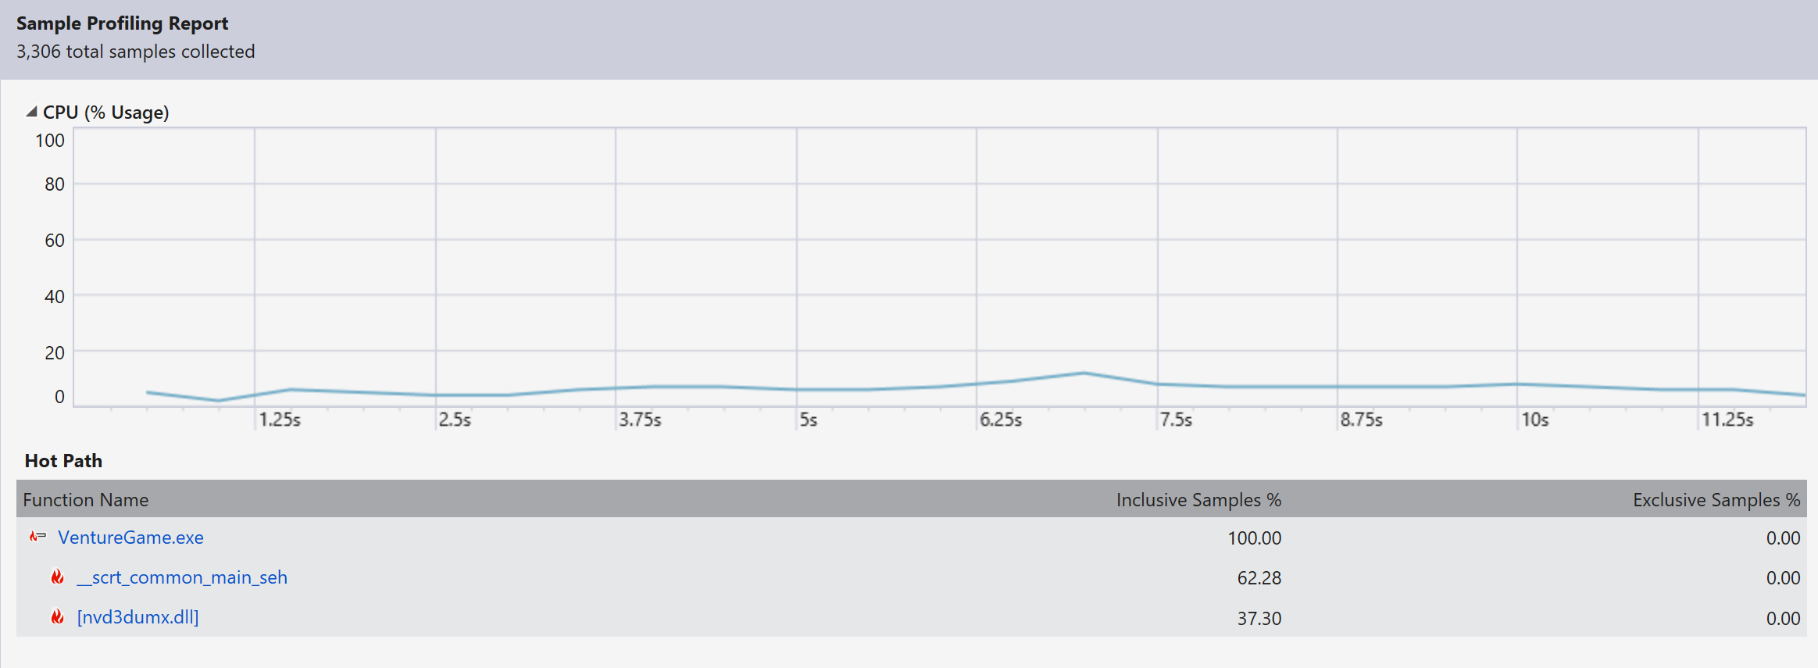
Stress Testing Game Features:
Pathfinding:
In previous benchmarks, I have not been focusing on performance of individual components, mainly just what uses the most processing for general walking around game play. However when specific components are overused by the player, i.e pathfinding or adding and removing lots of items from the inventory, this requires a lot of processing.
The pathfinding works in this game, by offsetting the search area from the start and end point, so that the area being searched is in the positive X and Y area of the level, this was due to not being able to have negative values in vectors.
The current pathfinding in this game searches an area of 100x100 around the start point.
To optimise this I will start by trying to dynamically scale the search area to the distance between the start and end points.
This is the CPU usage of when I was constantly adding and removing items from the inventory and pathfinding around the player
This simple code will reduce the amount of nodes that need to be created for searching a small area. Thus the function needs to spend less time creating the area to search, when it isn’t necessary to create so many nodes.
The drawback is that there isn’t a guaranteed path that it will be able to get, due to the limitations of the search area being based of the distance between the two points.
Before
After
Handle user input is the function that calls pathfinding, so I wills start with optimising that.

Slide 13
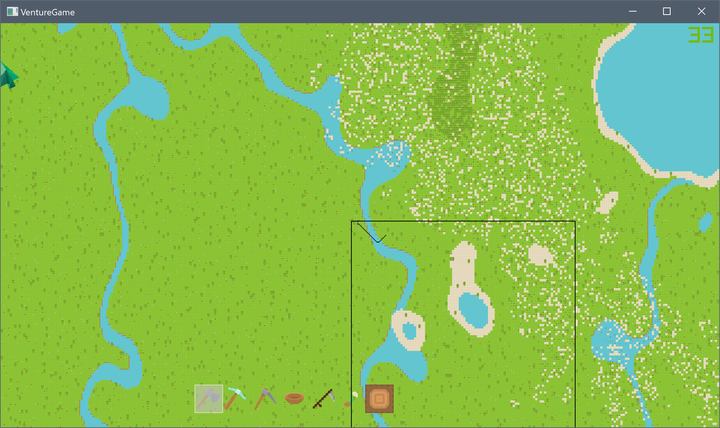
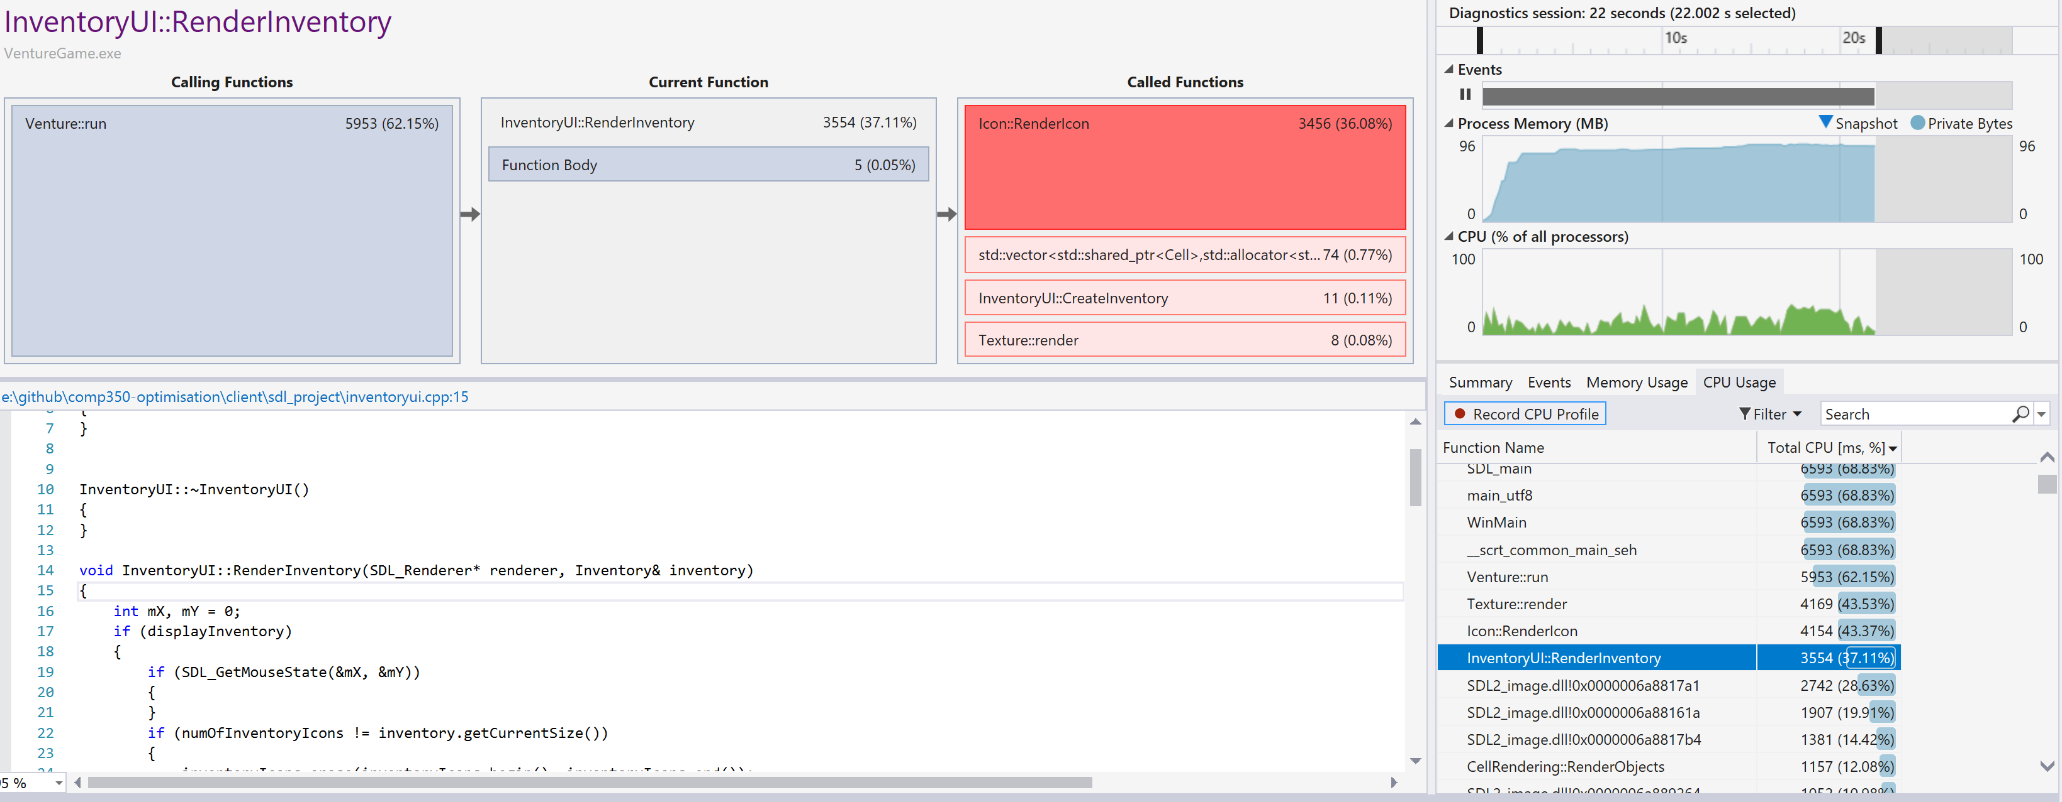
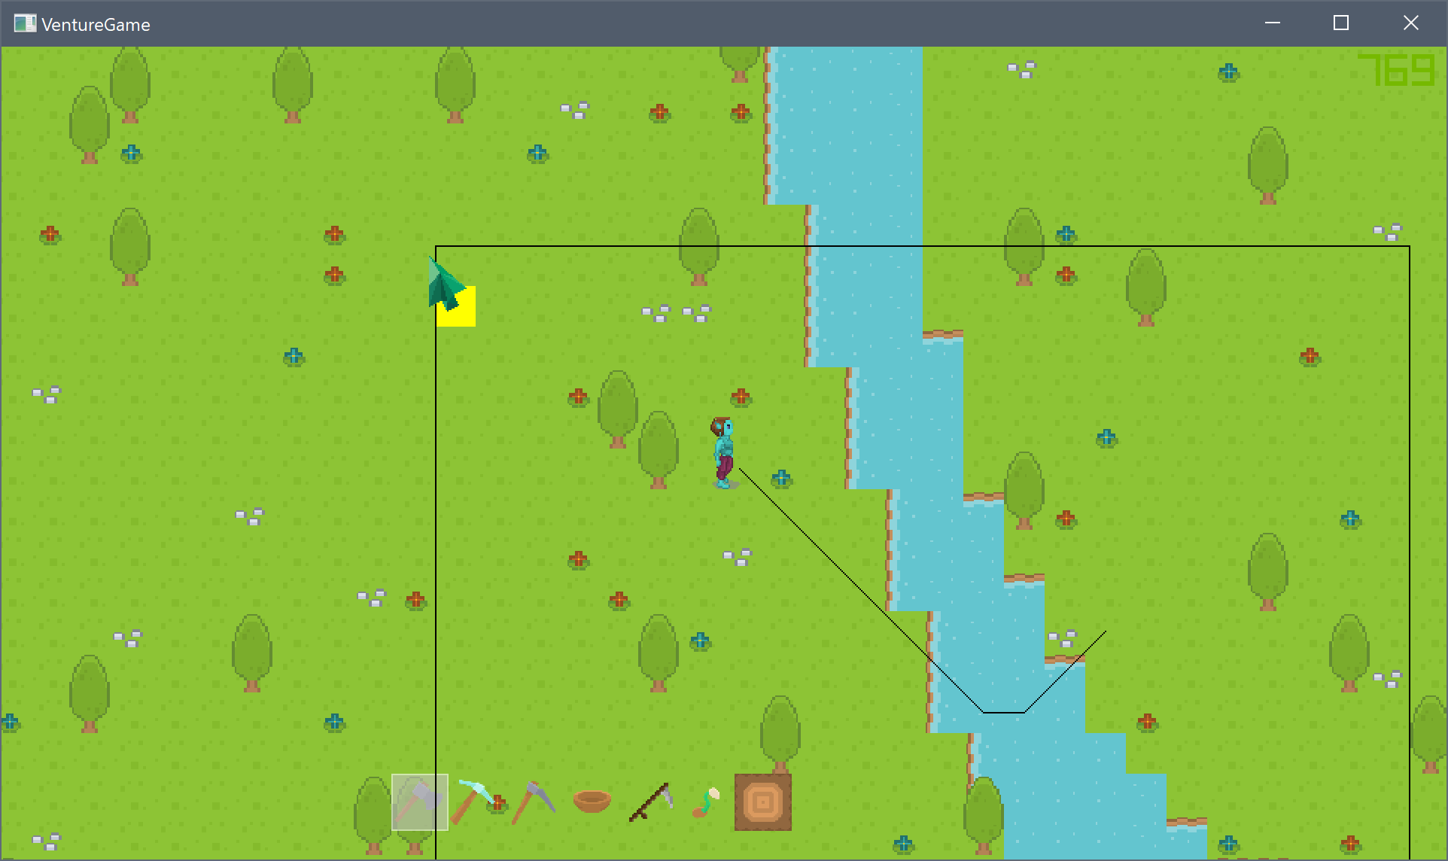
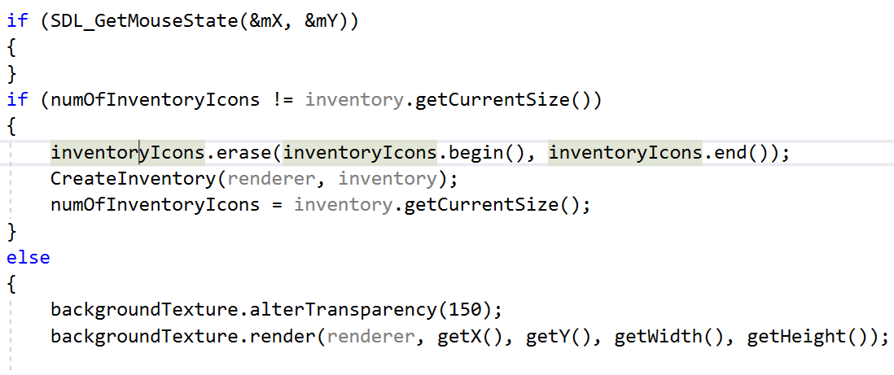
Pathfinding:
Inventory:
The size of the area of nodes being generated for each A* search is represented by the large black square.
Currently when the inventory is open, and the player collets or removes an item, the inventory is re-creating itself, which makes the game lag for a short while as it re-creates everything.
This bit of code checks if the size has changed, and if it has, it will refresh the inventory by deleting everything and re-create it. This is obviously really inefficient, and when I made it I was suppose to refactor it later, but never did.
Image of the pathfinding search area and path, after the change.
This bit of code checks if the size has changed, and if it has, it will refresh the inventory by deleting everything and re-create it. This is obviously really inefficient, and when I made it I was suppose to refactor it later, but never did.

Slide 14
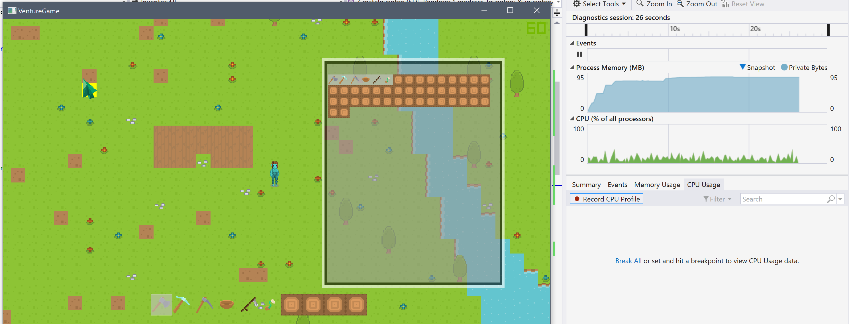
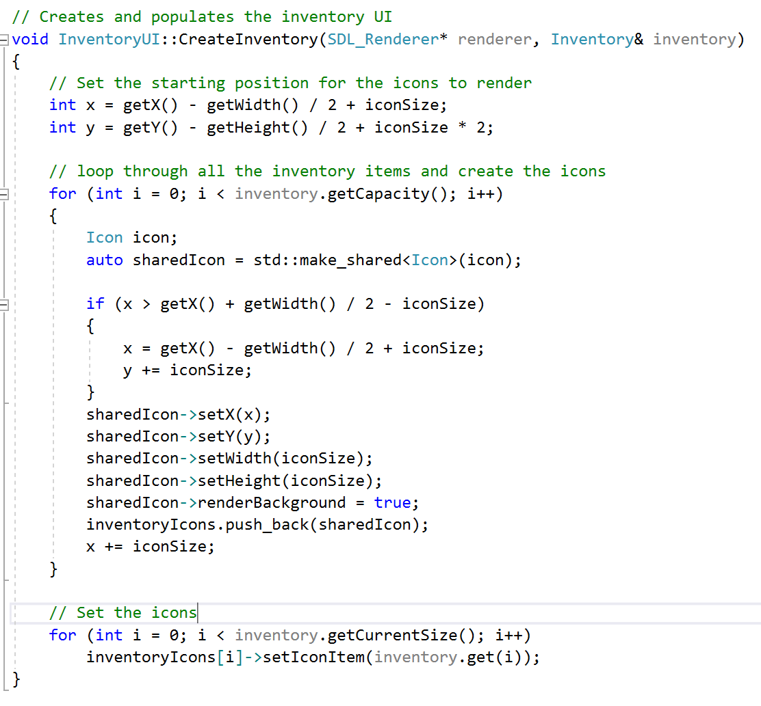
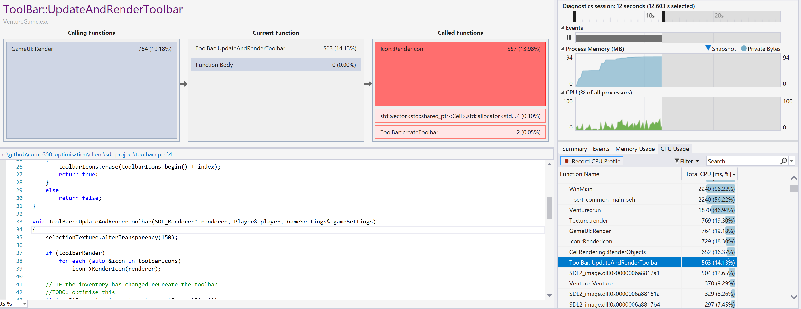
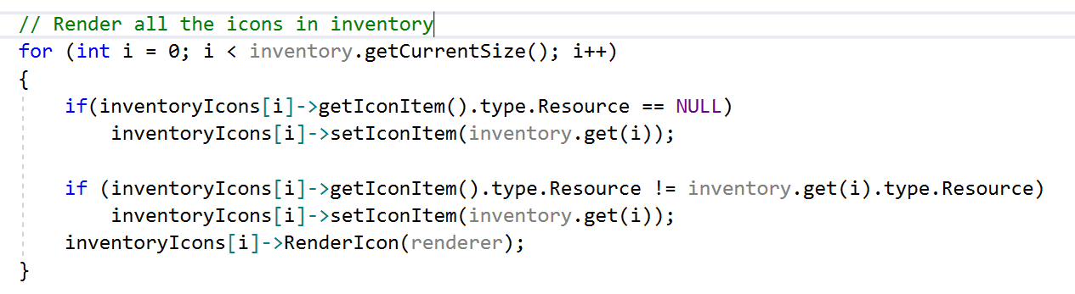
Inventory:
It’s hard to show in the profiler the results of this optimisation in the profiler, however now when anything is added or removed from the inventory, the game doesn’t judder and the inventory doesn’t flicker.
Old code, which simply deleted and created the inventory every time an item was added or removed.
The old code, which simply deleted and created the inventory every time an item was added or removed.
New code, doesn’t erase or create any items, just sets the value of the items to the same as the players inventory. Furthermore it only renders the current size, rather than the maximum size of the inventory.

Slide 15
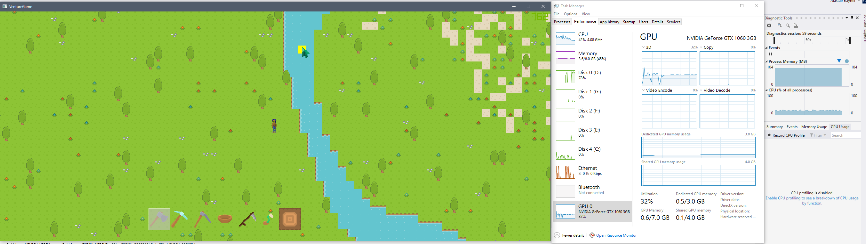
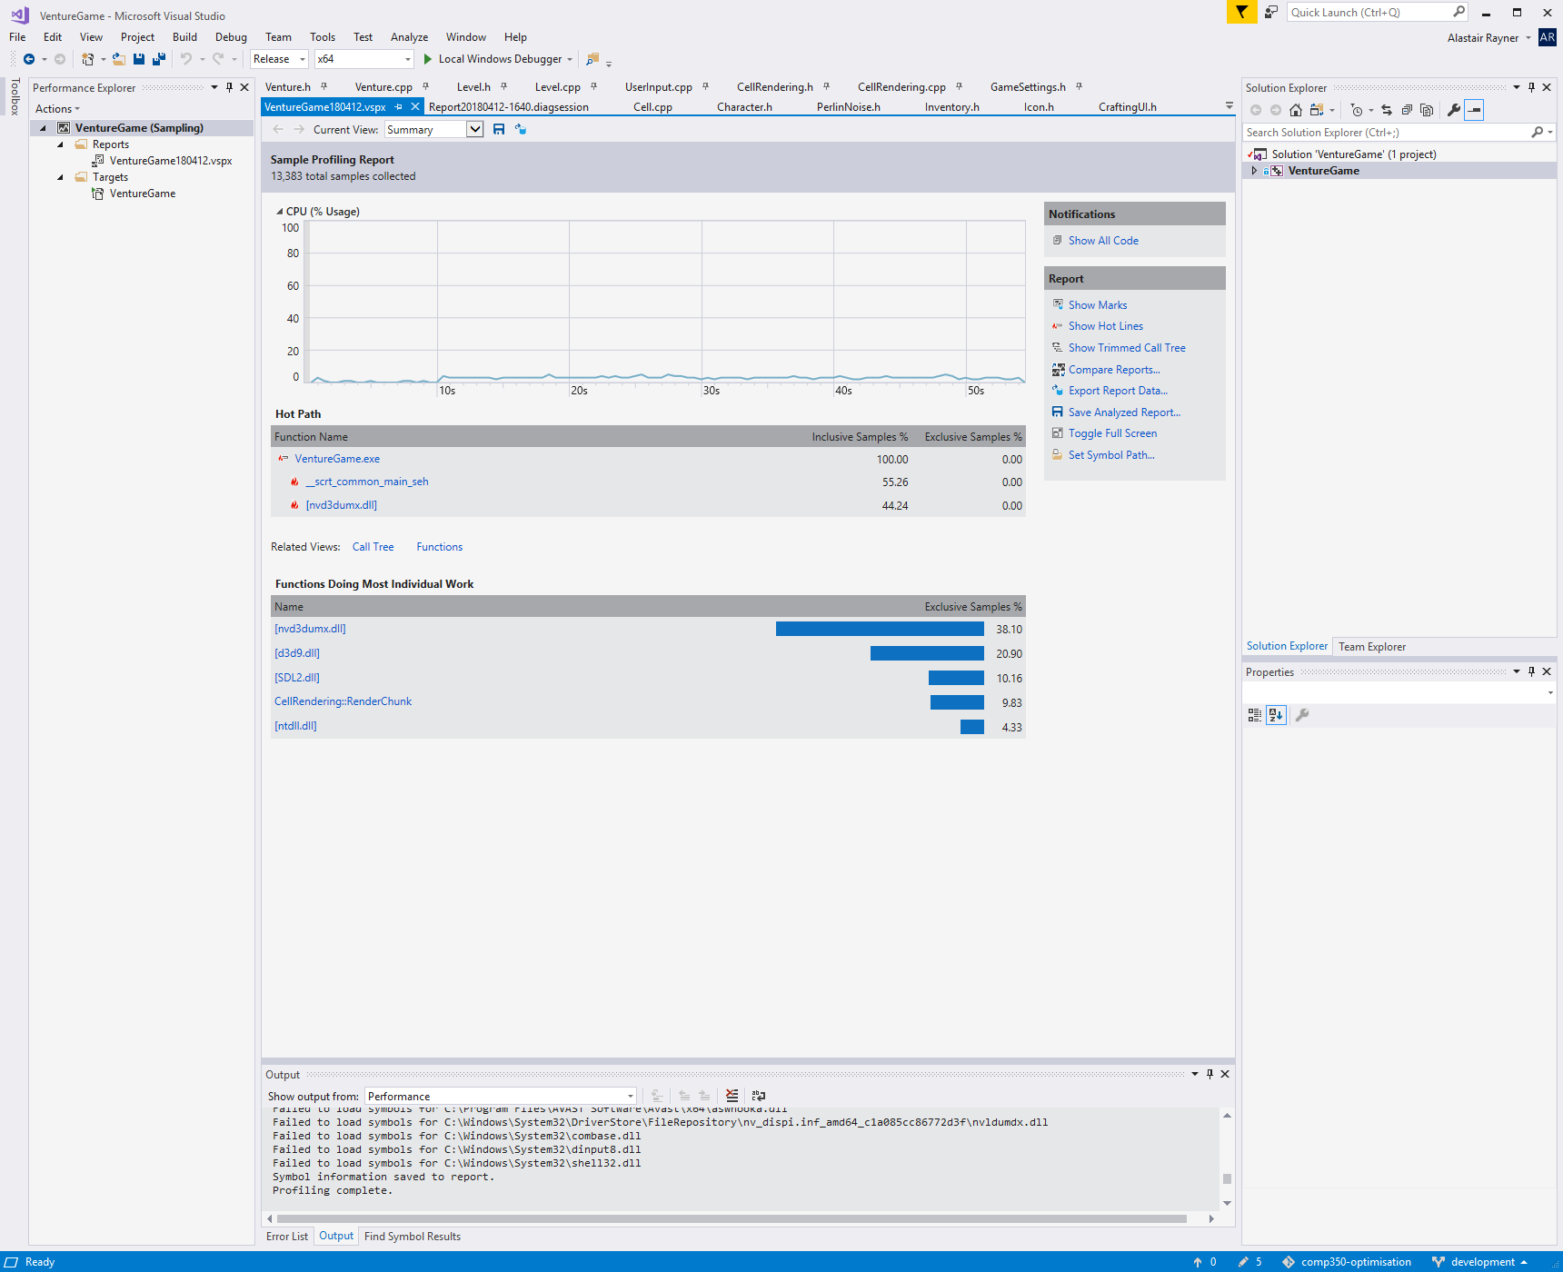
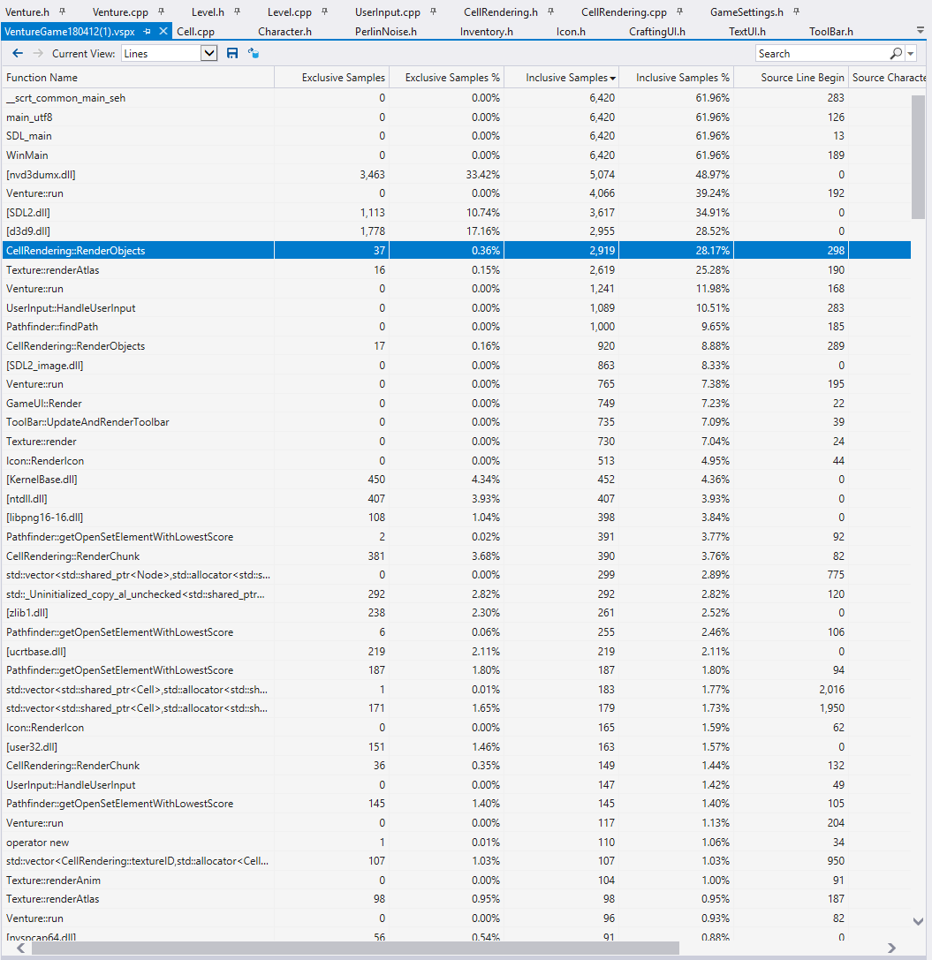
General Profiling:
When profiling all these results, I generally have windows task manager open aswell, as it is often a good tool to quickly identify bottlenecks.
When running in release mode, the Render Objects and render Atlas functions both are still the two largest resource hogs, using 2,919 and 2,600 inclusive samples. Compared to pathfinding which is using 1000.
The profiler has inclusive and exclusive samples, Inclusive samples is the amount of execution time spent in a function, including the time spent in functions that the function calls.
Exclusive samples is the time spent in that function, excluding the time spent in functions in that function.

Slide 16
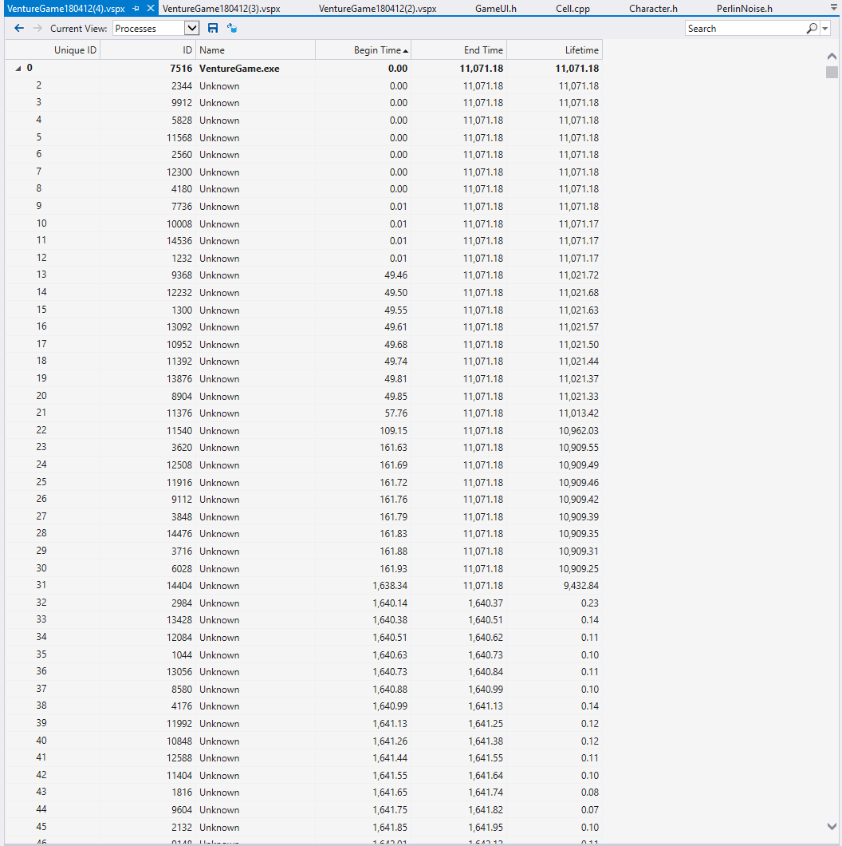
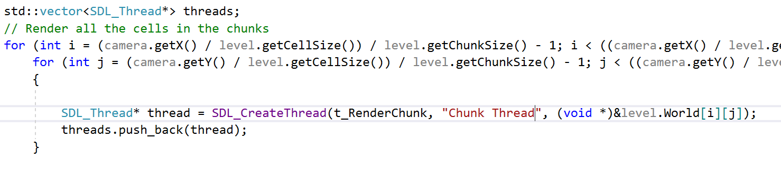
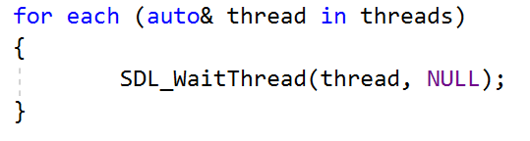
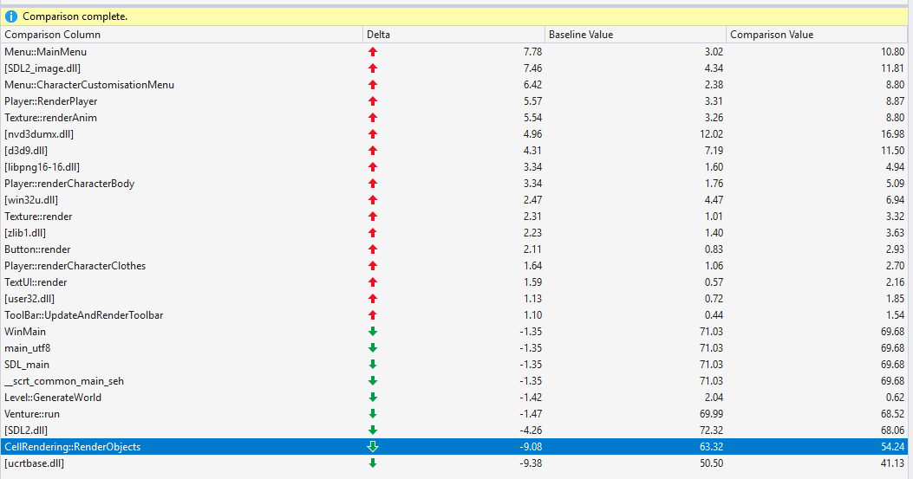
Concurrent Chunk Processing:
One of the ways I tried to tackle the optimisation of the cell rendering function, was to make it multi threaded. My idea was to make each chunk be able to process and render the cells inside it concurrently.
However as there are so many dependencies for the rendering of cells, this made it extremely difficult, and ended up creating more problems than it solved.
This is the performance difference from when I tried to do threading for my program. As I was creating and deleting so many threads, this lead to significantly decreased performance, as you can see on the right, all the threads being created as the time increases.
There were roughly 50,000 threads created for a 10 seconds game.
I ended up not implementing these changes as it decreased the performance and created a few bugs with the game.
The reason for why this decreased performance is due to it was creating a bunch of threads each frame, and each thread didn’t have much processing to do. All it was doing was rendering about 38 chunks, which had 8x8 cells.
The image to the left shows the decreased performance, of renderObjects, compared to a previous profiler run.
(Ignore the increase in menu performance, this is due to me having the menu open for a longer period than the previous run)
One improvement I will try to make in the future is to make the whole cell rendering class run in it’s own thread instead of creating a thread for each chunk. However the render function has a lot of dependencies that I will have to work around, which will take a lot of work.
As I have found multi-threading in C++ is significantly harder than when I did it in java.

Slide 17
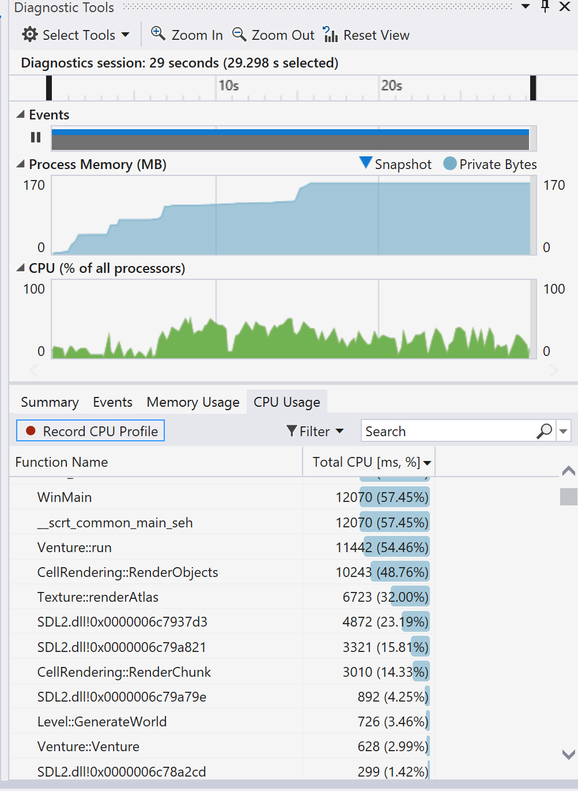
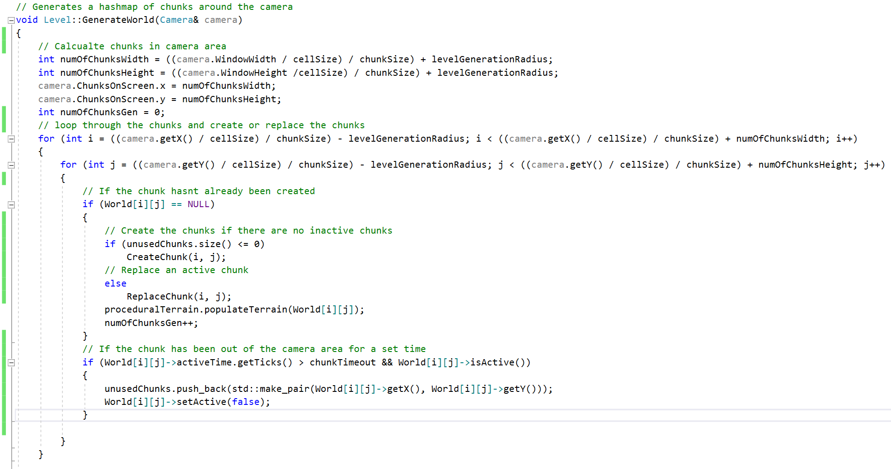
Chunk Object Pooling:
Possible solution:
The problem:
To try and fix this issue, I will create a timer on each chunk object, which is refreshed if the chunk is still on screen.
However when the chunk is offscreen and the chunks timer goes above a set threshold, the chunk will be added to the pool of empty chunks, which when the CreateChunk function is called, the chunk will be gathered from the pool of unused chunks.
As the player explores the level, the world generates chunks of tiles.
This process is costly as the game creates the Chunk object every while the player is moving, which can cause a slight judder as the chunk object is being created.
The solution:
I created a ReplaceChunk function that erases the tiles and recreates the new tiles, overwriting where the old, unused chunk data was.
It is currently adding the unused chunks to a vector of points, after the chunk is out of the camera view for 10 seconds.
Moreover the objects never actually get deleted, so the std::map of objects continually grows, which is okay if the player doesn’t explore very far, but if they this is a kind of memory leak, as the memory of the game will just continually increase.
This code loops through the chunks and then creates, replaces or adds it to a list of unused chunks

Slide 18
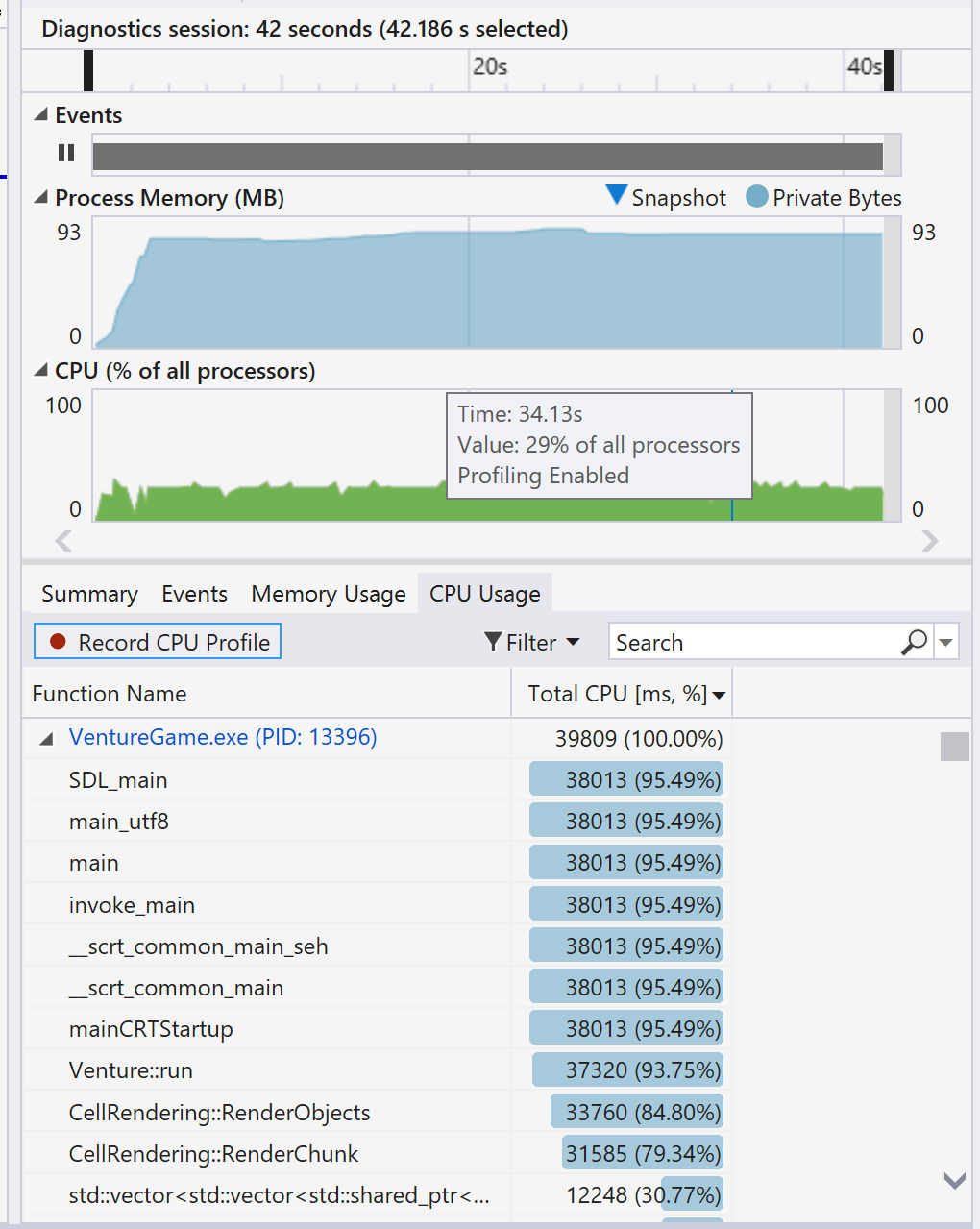
Chunk Object Pooling:
Checking:
Now when the player explores the level, the chunks that the player has been to, but is no longer in camera range, will get replaced with any new chunks data that gets created.
This shows a great improvement to memory performance, as the memory useage doesn’t constantly increase as the player explores the level, and instead stays level, with the new chunk data overwriting the old data.

Slide 19





Small Batch Rendering Change
When comparing the profiler from before and after the change, the performance was significantly greater.
When I was looking over the rendering, I realised I was looping through a large vector twice, this could be resolved by creating two different vectors, of different sizes.
Because currently I had one vector of all the textures locations in the level, which I was looping over once before I rendered the player, and then again to render over the player. This means there was a lot of loops that were not actually doing anything.
To rectify this I simply created two different vectors, and when I added the texture, checked which vector it should go in with a simple if else statement.
This is such a small change, however because there were so many textures, which had to be looped over each frame, it had a significant impact.

Slide 20
Conclusion
Throughout this optimisation process, I have been focusing on the large scale improvements to the algorithms within the game, rather than micro optimisations.
However throughout this process I have been doing micro optimisations for variables, i.e. using char or short, instead of int or double, where appropriate. This is not mentioned in the report, because I wasn’t sure how to document all the minor changes, but they are available on my github fork.
Almost all the changes made in this game were for the CPU, as SDL manages most of the GPU stuff for you, moreover the GPU was not the bottleneck throughout the process, and the main issue with my code, was that it is only single threaded, however I struggled with implementing C++ multi-threading, and when I finally got it working, there was a decrease in performance, I decided to work on other optimisations I could do instead.

